Slide 1

BC2410, Prescriptive Analytics From Data to Decisions
Lecture 4

Slide 2
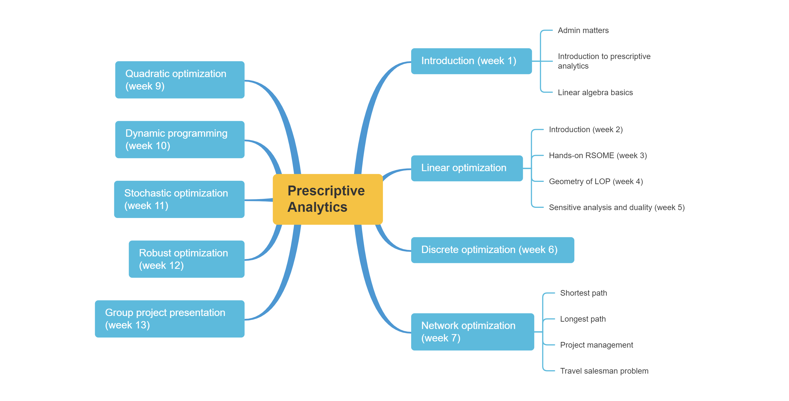
Schedule

Slide 3
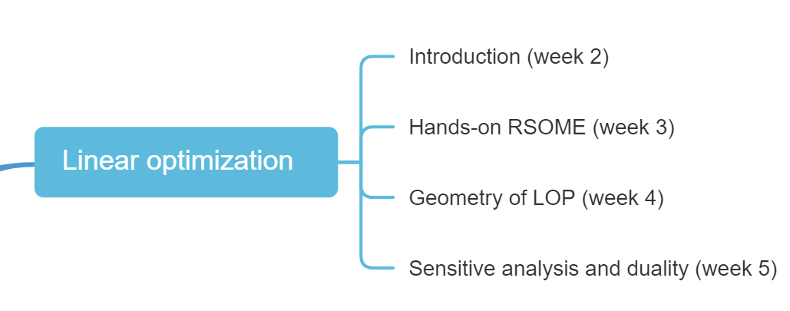
Schedule

Slide 4
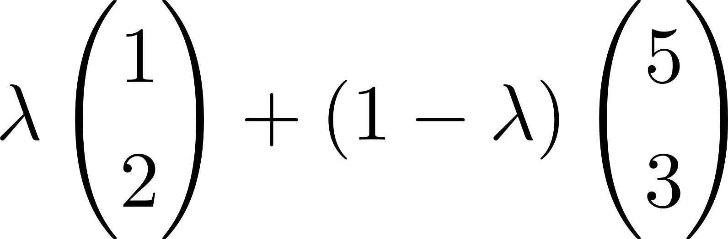
What is the meaning of this?

Slide 5
What is the meaning of this?
x₂
(1, 2)
2
0
1
x₁

Slide 6
What is the meaning of this?
x₂
(5, 3)
3
(1, 2)
2
0
1
5
x₁

Slide 7
What is the meaning of this?
x₂
(5, 3)
3
(1, 2)
2
0
1
5
x₁
Notes:
When lambda is in [0,1], it is a line segement.
When lambda <= 0, it is a ray with (5,3) as the origin

Slide 8
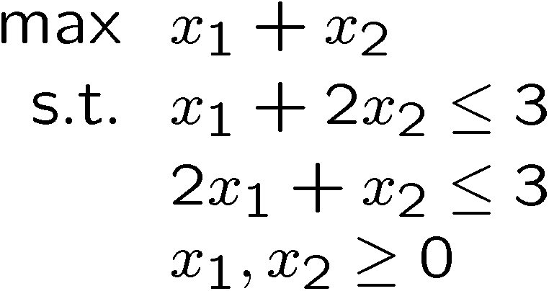
Geometry of LOP in 2D
Each dimension represents a decision variable
Each point in the space represents a particular solution
x₂
(2, 3)
3
0
2
x₁
Notes:
Each point is a solution, but each solution could be feasible or infeasible

Slide 9
Geometry of LOP in 2D
Equality: x₁ = 0
x₂
x₁ = 0
0
x₁

Slide 10
Geometry of LOP in 2D
Inequality constraint x₁ ≥ 0 defines a half space
x₂
x₁ ≥ 0
0
x₁

Slide 11
Geometry of LOP in 2D
Equality: x₂ = 0
x₂
0
x₁
x₂ = 0

Slide 12
Geometry of LOP in 2D
Inequality constraint x₂ ≥ 0 defines a half space
x₂
x₂ ≥ 0
0
x₁

Slide 13
Geometry of LOP in 2D
Equality: 2x₁ + x₂ = 3
x₂
(0, 3)
0
x₁
0

Slide 14
Geometry of LOP in 2D
Equality: 2x₁ + x₂ = 3
x₂
(0, 3)
0
(1.5, 0)
x₁
0

Slide 15
Geometry of LOP in 2D
Equality: 2x₁ + x₂ = 3
x₂
2x₁ + x₂ = 3
(0, 3)
0
(1.5, 0)
x₁
0

Slide 16
Geometry of LOP in 2D
Inequality constraint 2x₁ + x₂ ≤ 3 defines a half space
x₂
2x₁ + x₂ = 3
(0, 3)
2x₁ + x₂ ≤ 3
0
(1.5, 0)
x₁
0

Slide 17
Geometry of LOP in 2D
Inequality constraint x₁ + 2x₂ ≤ 3 defines a half space
x₂
x₁ +2x₂ = 3
(0, 1.5)
x₁ + 2x₂ ≤ 3
0
x₁
0
(3, 0)
0

Slide 18
Geometry of LOP in 2D
The intersection of all the constraints ⇒ Feasible Region
x₂
0
x₁
0
0

Slide 19
Geometry of LOP in 2D
Feasible Region: The set of all the allowed solutions; a region (polygon) bounded by the constraints
Each equality constraint defines a line
Each inequality constraint defines a half-space
Extreme Points: Corner points on the boundary of the feasible region. E.g., (0, 0), (1.5, 0), (0, 1.5), and (1, 1)
Infeasible problem: A problem with an empty feasible region
x₂
0
x₁

Slide 20
Geometry of LOP in 2D
Objective: maximize x₁ + x₂
Isoquant: A line on which all points have the same objective value; all points are equally good on the objective function.
x₂
x₁ + x₂ = 0
0
x₁

Slide 21
Geometry of LOP in 2D
Optimal Solution: The best feasible solution
For any feasible LOP with a finite optimal solution, there exists an optimal solution that is an extreme point
x₂
max x₁ + x₂
Optimal Solution:
(1, 1)
0
x₁
x₁ + x₂ = 2
Notes:
Try to obtain the optimal solution for
Min x1 + x2
Max x1 – x2
Min x1 – x2
How to obtain the direction?
Depends on your objective (min/max) and the sign of the parameter of each variable.
For example, for max x1 – x2, we want x1 to be as large as possible, while x2 as small as possible, so we choose the “downside” direction

Slide 22
Geometry of LOP in 2D
Optimal solutions may NOT be unique
x₂
max 2x₁ + x₂
0
x₁

Slide 23
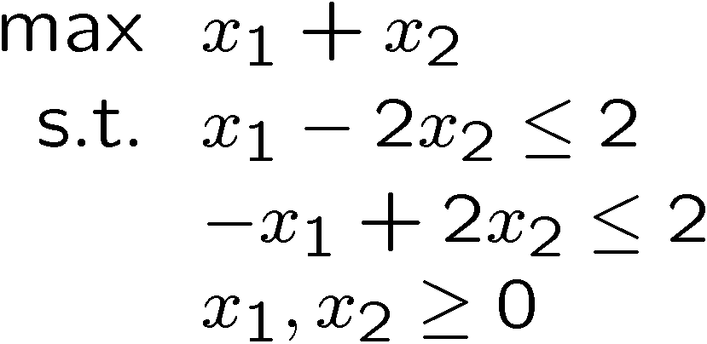
Geometry of LOP in 2D
Optimal solution may NOT be finite
-x₁ + 2x₂ ≤ 2
x₂
max x₁ + x₂
x₁ – 2x₂ ≤ 2
(0, 1)
0
(2, 0)
x₁

Slide 24
Preliminary insights
Solutions of LOP
Unique optimal solution
Multiple optimal solutions
The optimal objective is not finite and no feasible solution is optimal
Infeasible

Slide 25
Active constraints
Binding (or active) constraints: The constraints that are satisfied at equality for a given solution
All equality constraints are binding by definition
Non-binding (or inactive) constraints are satisfied at strict inequality for a given solution
The inequality level (= RHS – LHS) is known as the slack
Binding constraints have zero slack by definition
Notes:
Select any feasible solution, substitute in all the constraints, if the constraint is tight, then it is binding/active with 0 slack. Ow, it is non-binding/inactive.
But the slack is calculated as RHS – LHS of LHS <= RHS.

Slide 26
Active constraints
Constraints | Binding? | Slack
x₁ + 2x₂ ≤ 3 | Yes | 0
2x₁ + x₂ ≤ 3 | Yes | 0
x₁ ≥ 0 | No | 1
x₂ ≥ 0 | No | 1
(1, 1)

Slide 27
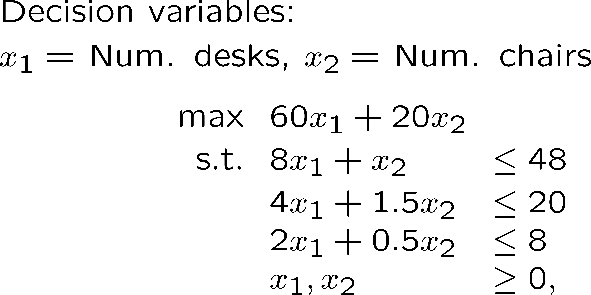
The Furniture Problem
Notes:
(x1, x2) = (2,8)

Slide 28
Beyond 2D - Central Problem

Slide 29
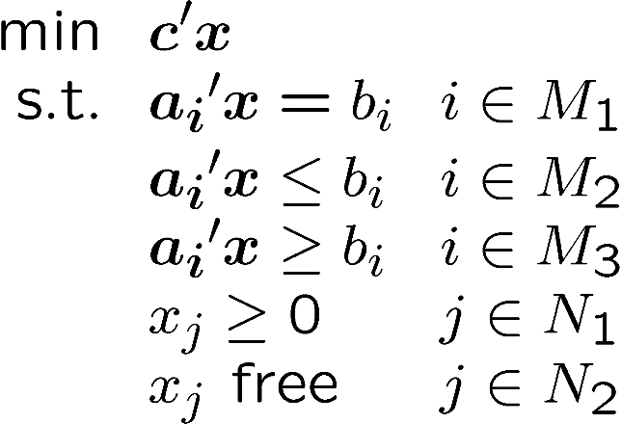
Beyond 2D - Central Problem
Notes:
This just to show you that each inequality can be equivalently written as “<=”, “>=”, or “=”

Slide 30
Standard Form
Useful in computation
The Simplex and interior point method
Reduction to standard form
Elimination of free variables
Elimination of inequality constraints

Slide 31
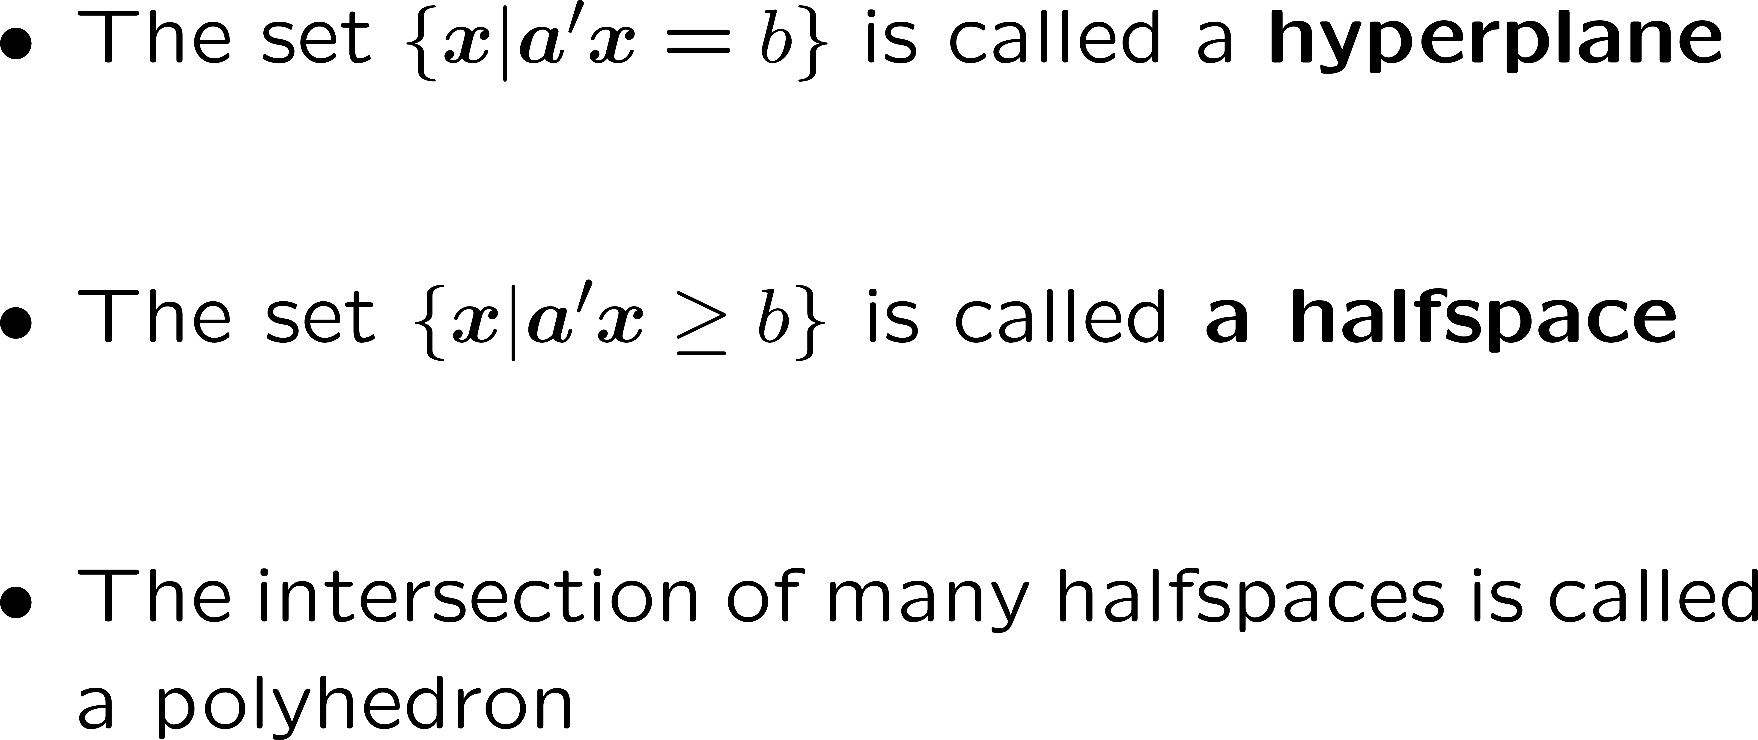
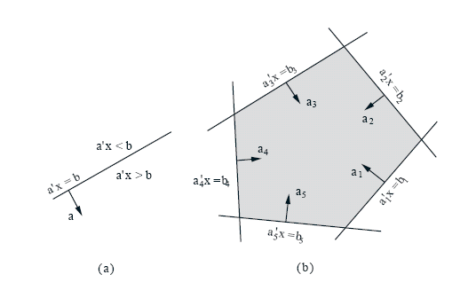
Polyhedra
Definitions
Notes:
You need to know this definition.

Slide 32
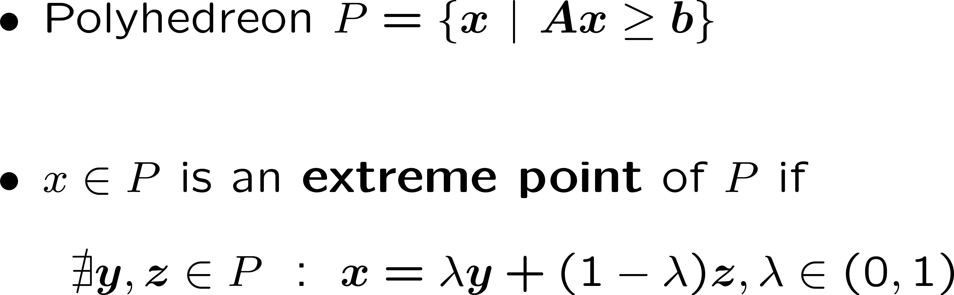
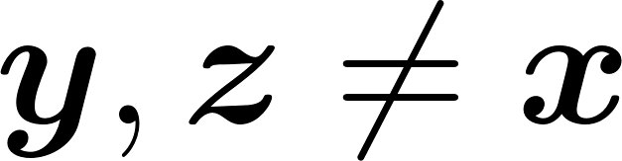
Corners
Extreme points
Notes:
You just need to know extreme points, vertex, and BFS, all are definitions of corners. They are equivalent.

Slide 33
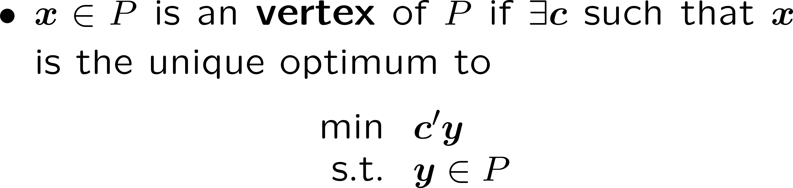
Corners (Optional)
Vertex

Slide 34
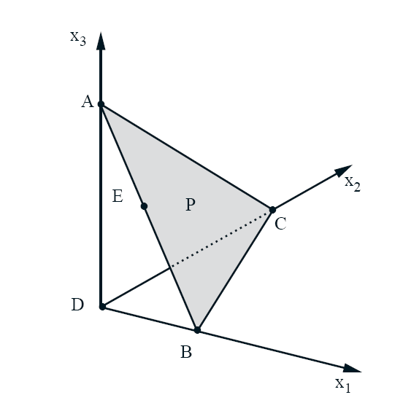
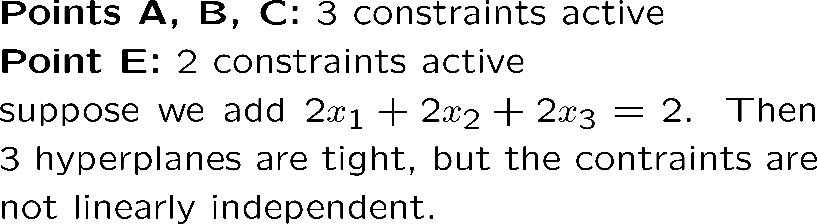
Corners (Optional)
Basic Feasible solution

Slide 35
Corners (Optional)
Definition: x is a basic feasible solution if x is the only feasible element of Y.

Slide 36
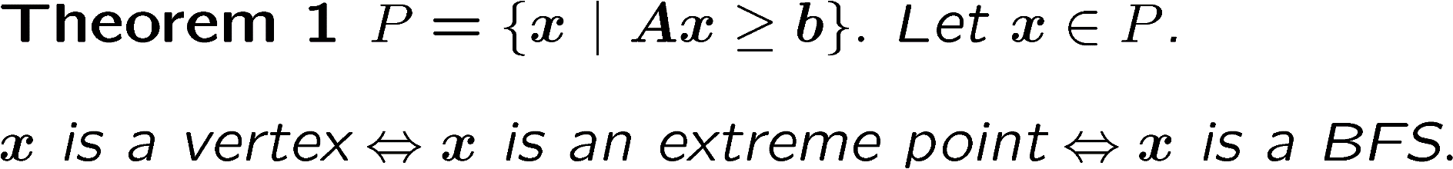
Equivalence of Definition (Optional)

Slide 37
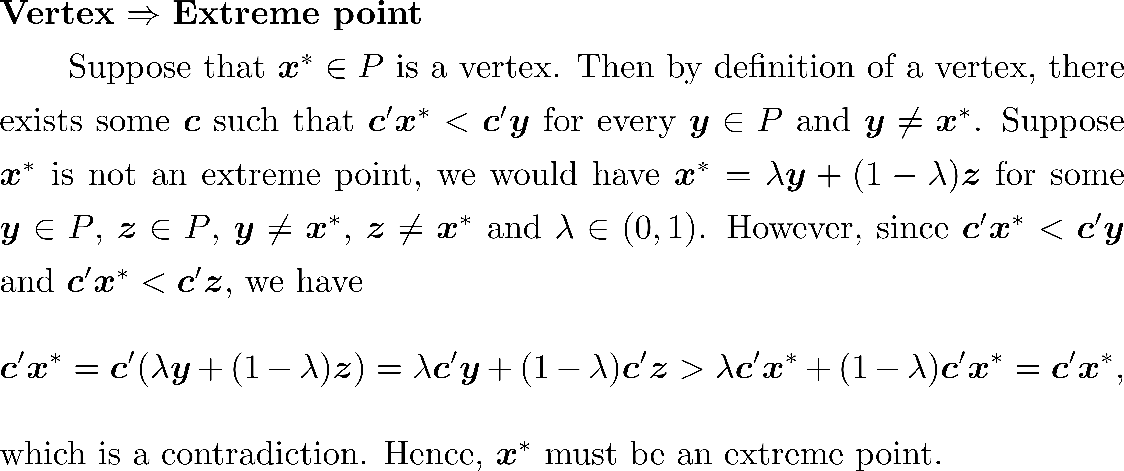
Equivalence of Definition (Optional)

Slide 38
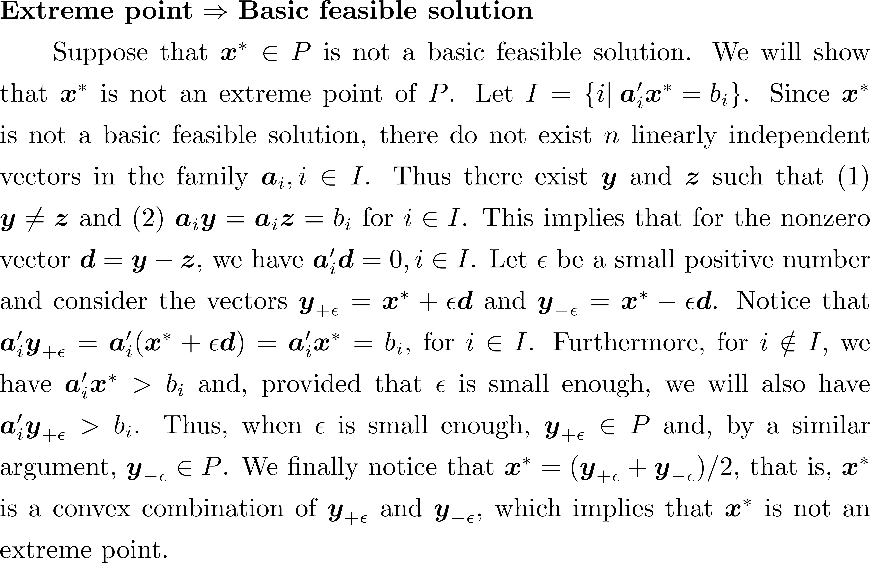
Equivalence of Definition (Optional)

Slide 39
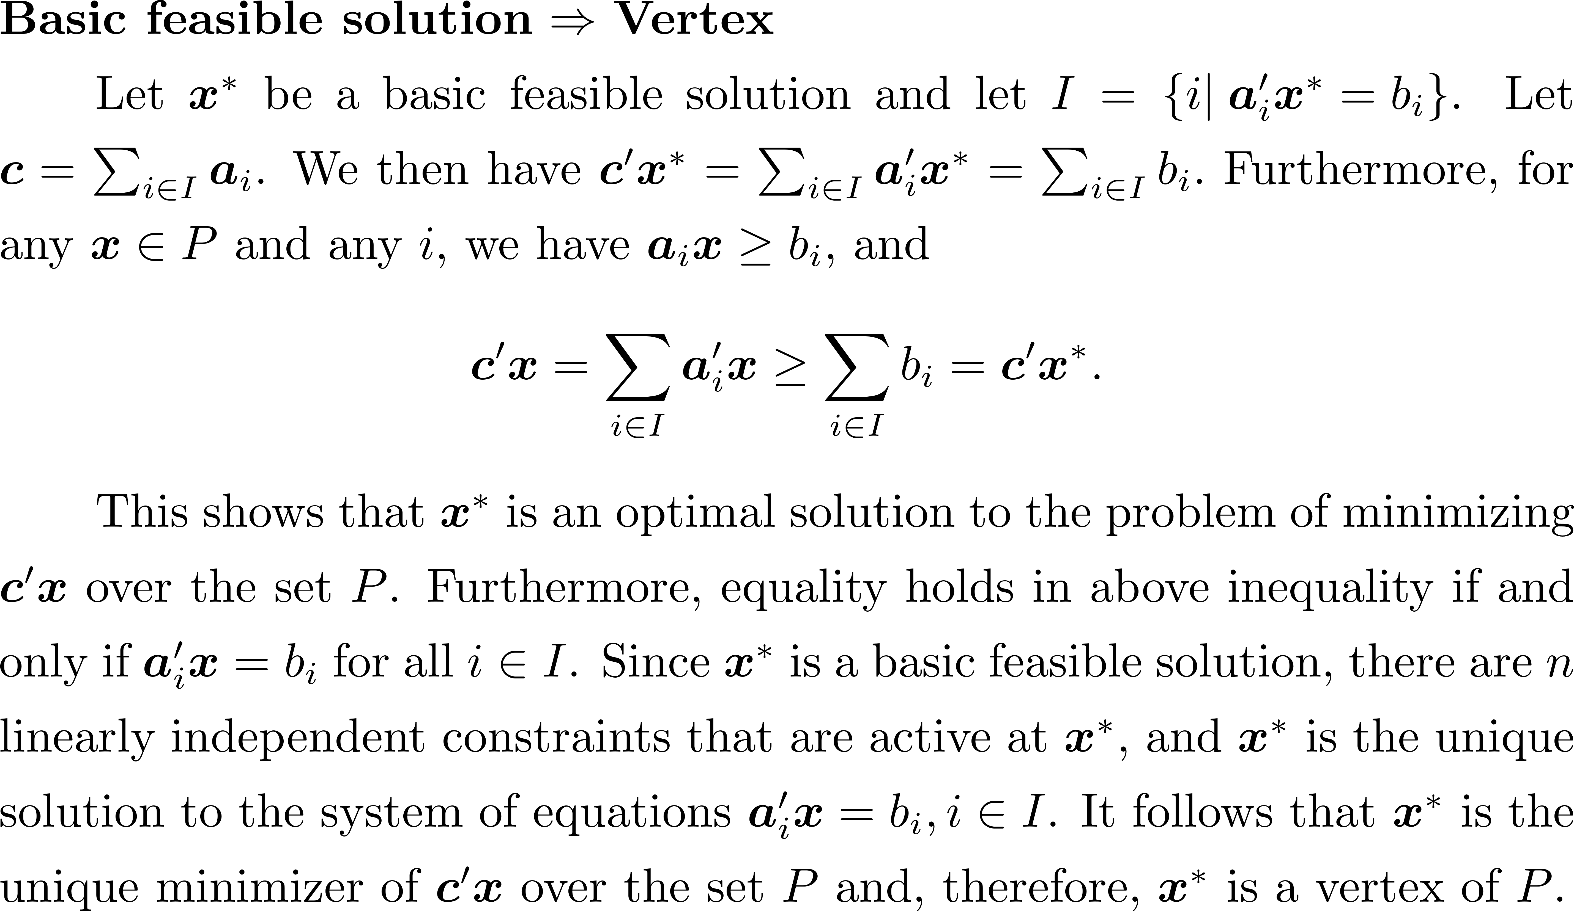
Equivalence of Definition (Optional)

Slide 40
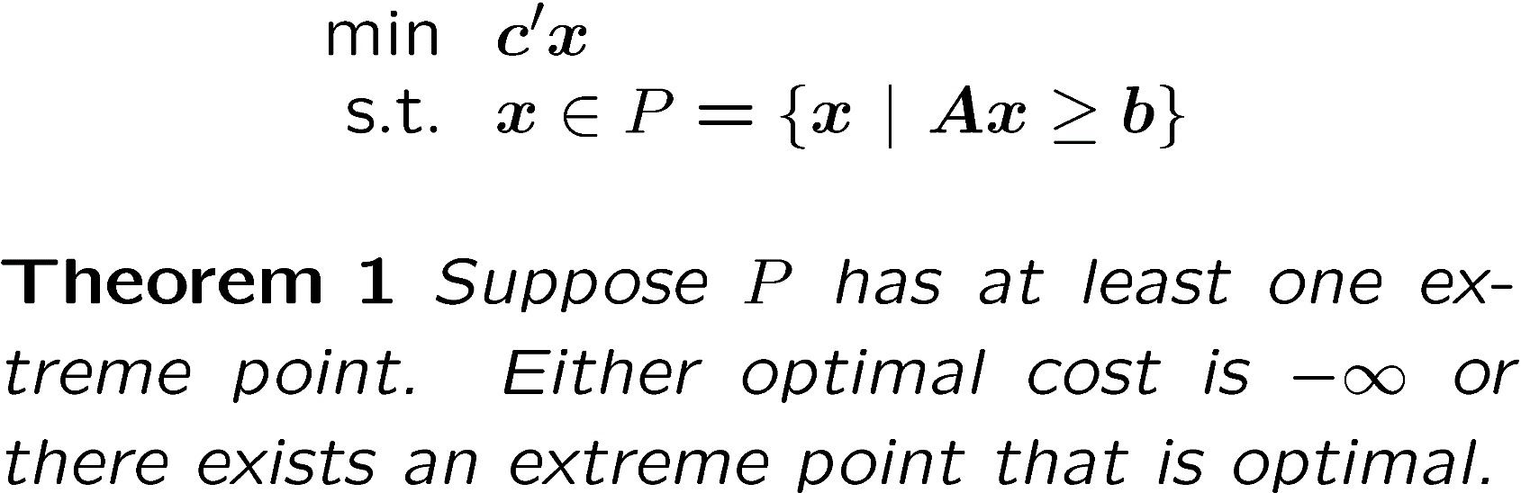
Optimality of BFS

Slide 41
Conceptual Simplex Algorithm (Optional)
Start at an extreme point (BFS)
Visit a neighboring corner that improves objective

Slide 42
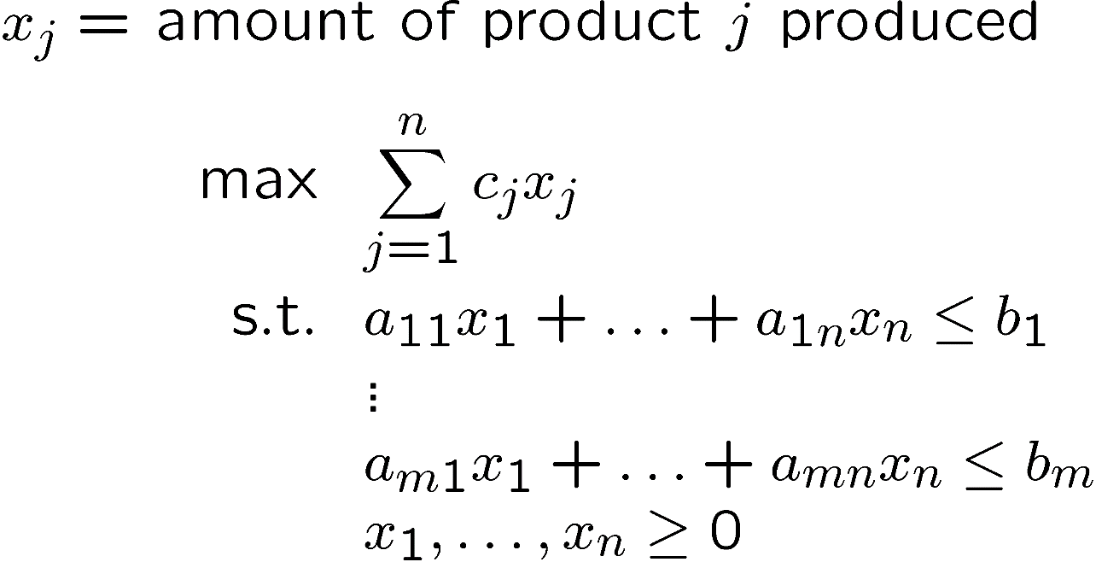
BFS of Manufacturing Problem (Optional)
BFS has at most m positive productions.

Slide 43
Basic and Non-Basic Variables (Optional)
There exists exactly n set of binding constraints to define a BFS.
Non basic variables correspond to those nonnegative constraints that are in the set of n binding constraints. The rest are called basic variables.
By definition, non basic variables must have zero values.
Basic variables are usually nonzero but they could be zero in degenerate cases.

Slide 44
Degeneracy (Optional)
A BFS can have more than n set of binding constraints
Degeneracy

